Slide 1



Wash my car

Slide 2
group members names
Fahad Khaled alofani
Nawaf Abdullah albeajan
Abdullah essa albanyan
Saud ibraheem altamimi

Slide 3
Main points
Use case
Activity Diagram
Class Diagram
Mobile App Interface

Slide 4
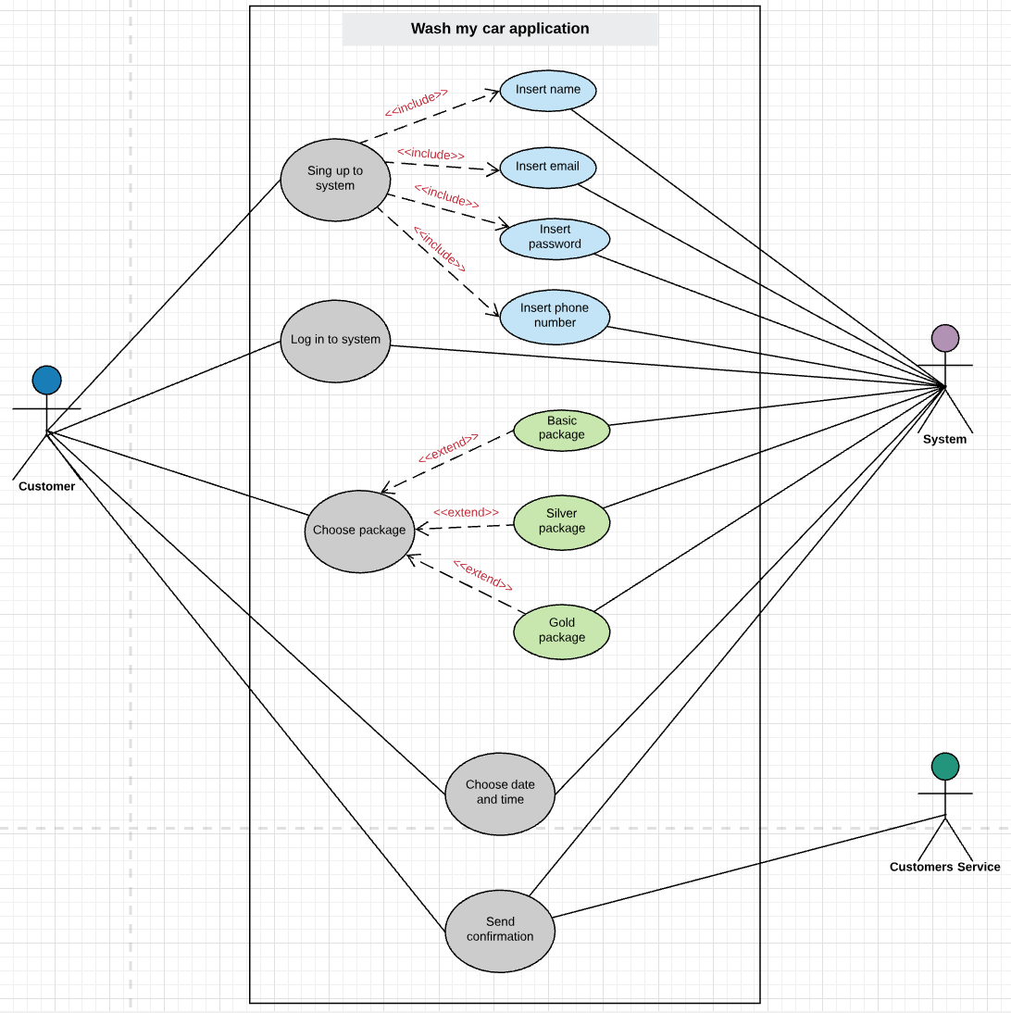
Use case

Slide 5
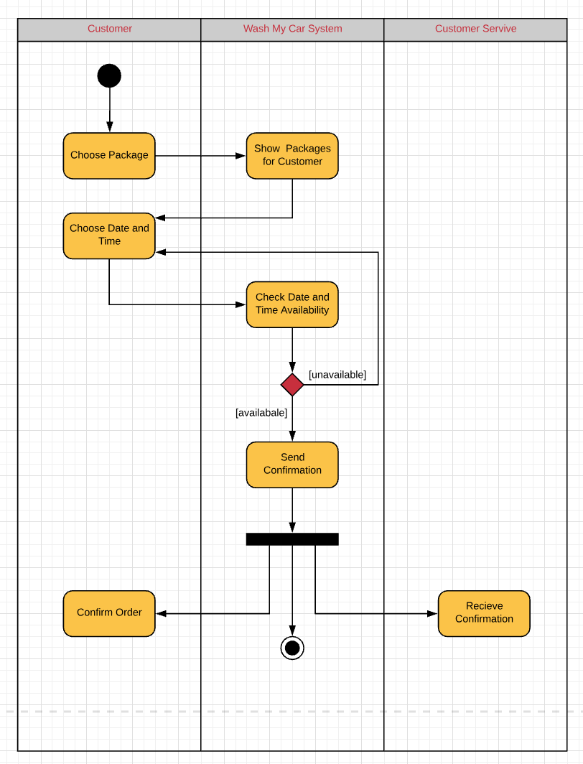
Activity Diagram

Slide 6
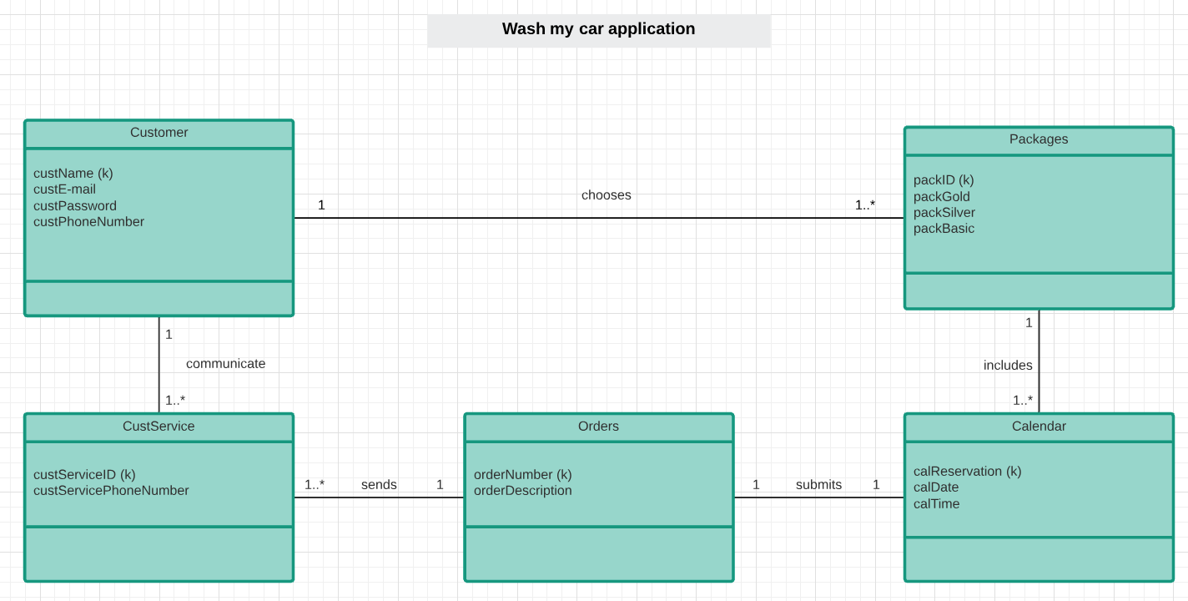
Class Diagram

Slide 7
Mobile App Interface
https://pr.to/3YVS84/

Slide 8
Any question?

Slide 9
Thank you for listening…

